Slide 1

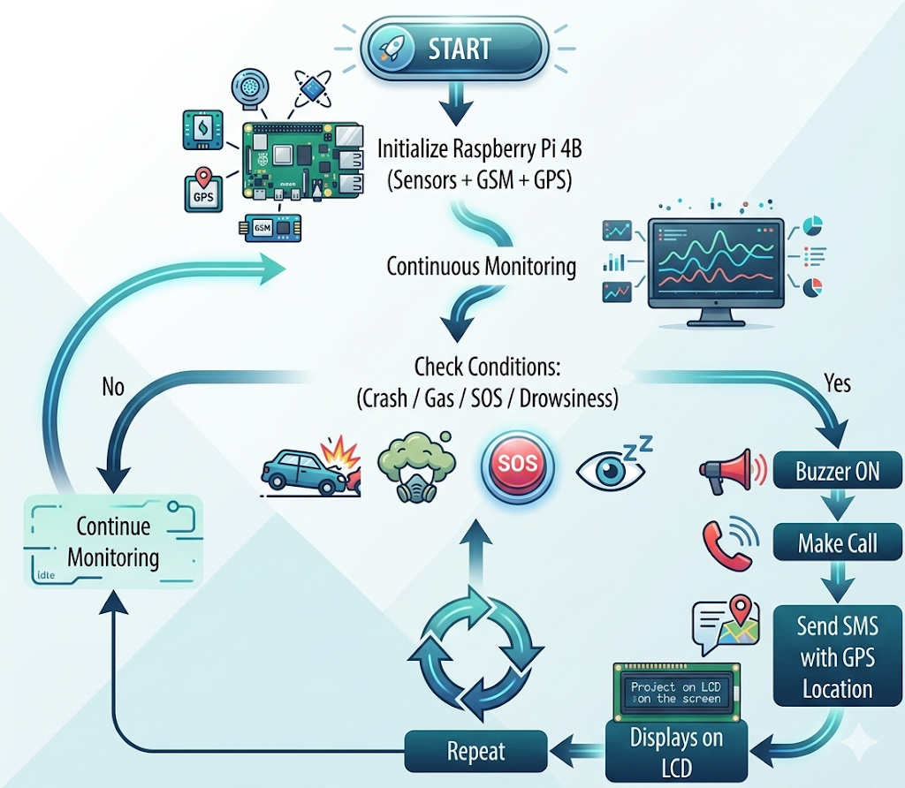
I-CARE : Intelligent Car Accident Response Emergency Locator
SRNs: 02FE22BEC054, 02FE22BEC058
Student Names: Priyanka, Pruthviraj Guide: Dr. Dattaprasad Torse
Context: Traditional vehicle safety systems fail to help incapacitated victims, relying on unpredictable bystander reporting. I-CARE bridges this "Golden Hour" gap by integrating IoT and Computer Vision to detect crashes and driver fatigue automatically. By triggering instant GPS alerts without human intervention, the system provides a low-cost, life-saving solution for proactive accident prevention and rapid emergency response.
Problem Statement:Current safety systems rely on bystander help, causing fatal delays for incapacitated victims. I-CARE automates hazard detection and GPS alerts to ensure instant rescue and prevent fatigue-related crashes..
Deliverables :
Autonomous Detection System
Automated Alert Module
Validated Performance Data
Parable
Drivable
Training / Pre-Requisites
Proficiency in Python/OpenCV, Raspberry Pi hardware interfacing, and EAR sensor calibration.
Timeline
Starter Reference Material
U. Alvi et al., "A Comprehensive Study on IoT Based Accident Detection Systems for Smart Vehicles," IEEE Access, vol. 8, 2020
Kishore S & Rekha R Nair, "Enhancing Road Safety: A Smart Accident Alert System for Rapid Emergency Response."
Nicky Kattukkaran et al., "Intelligent Accident Detection and Alert System for Emergency Medical Assistance
S. Saponara et al., "Real-time video fire/smoke detection based on CNN in antifire surveillance systems," Journal of Real-Time Image Processing, 2021
.
Kick Off < 1st Month >
Milestone 1 < 2nd Month >
Milestone 2 < 3rd & 4th Month
Design & Procurement –
Hardware selection
Circuit design
Environment setup for Python/OpenCV.
Development & Integration
Coding CV modules.
Sensor interfacing, configuring GSM/GPS alerts.
Testing & Validation
System calibration,
Performance accuracy testing
Final prototype assembly.

